Slide 1
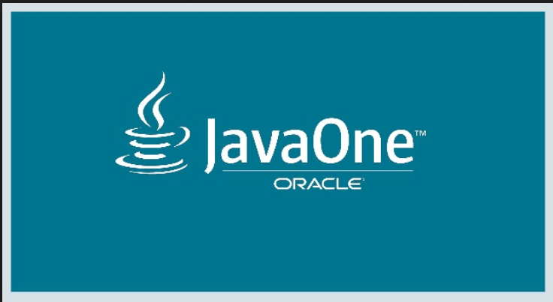
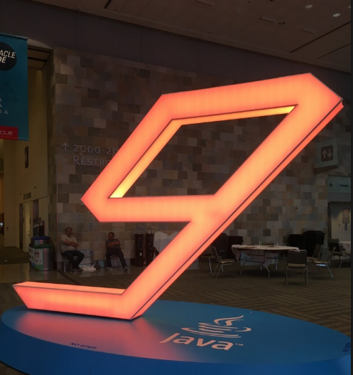




Java One – 2017 ( Oct 1 - 5 ) – San Francisco ,CA
Subhash Koganti
skoganti@archmi.com

Slide 2



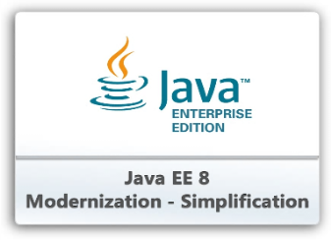



Buzzwords from Java One - OCT 2017
Java 9 Modularity
Java EE 8 / EE4J / Microprofile
Server less Cloud Computing
Micro Services/Cloud Native Applications/Containerization
Reactive Programming
Machine Learning
Java For Mobile App Development

Slide 3
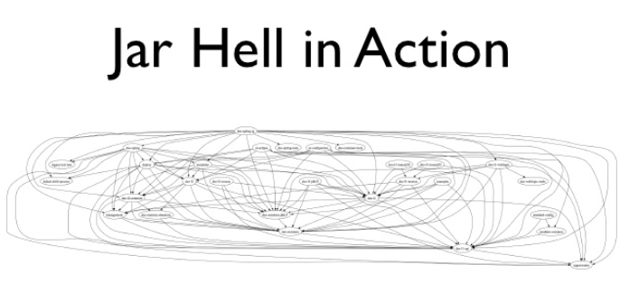
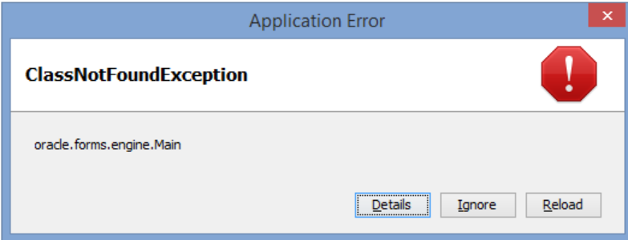

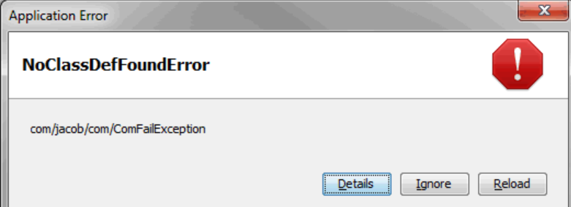
Java 9 Modularity – Problems with classpath
Brittle and Hard to manage Runtime Class path in Java
Monolithic Applications with heavy memory usage and vulnerable to fail easily

Slide 4
Java 9 Modularity – Monolithic & Brittle classpath
classpath:
com.app.jar1,com.app.jar2,com.app.jar3,com.app.jar4,com.app.jar5,com.app.jar6,com.app.jar7,com.app.jar8,com.app.jar9,com.app.jar10,com.app.jar11,com.app.jar12,com.app.jar13,com.ap.jar14,com.app.jar15,com.app.jar16,com.app.jar17,com.app.jar18,com.app.jar19,com.thirdparty.jar1, com.thirdparty.jar2, com.thirdparty.jar3, com.thirdparty.jar3, com.thirdparty.jar4, com.thirdparty.jar4, com.thirdparty.jar4, com.thirdparty.jar6, com.thirdparty.jar7, com.thirdparty.jar8, com.thirdparty.jar9, com.thirdparty.jar10, com.thirdparty.jar11, com.thirdparty.jar12, com.thirdparty.jar13, com.thirdparty.jar14, com.thirdparty.jar15, com.thirdparty.jar16, com.thirdparty.jar17, com.thirdparty.jar18, com.thirdparty.jar19, com.thirdparty.jar20, com.thirdparty.jar21, com.thirdparty.dependency1.jar1, com.thirdparty.dependency1.jar2, com.thirdparty.dependency1.jar2, com.thirdparty.dependency1.jar3, com.thirdparty.dependency1.dependency1.jar1, com.thirdparty.dependency1.dependency2.jar1,com.thirdparty.dependency1.dependency2.jar1 com.thirdparty.dependency1.dependency2.jar2,com.thirdparty.dependency3.dependency2.jar4 com.thirdparty.dependency5.dependency2.jar6,com.thirdparty.dependency7.dependency2.jar8
NoClassDefFoundError

Slide 5
Java 9 Modularity – How to solve the classpath problems ?
We need Reliable Configuration
We Need Strong Encapsulation and Abstraction
We need ability to package what you only need and not other unnecessary stuff .
We need to be able to conceal your international Implementations
We need to be able to plug and play a feature / module
We need to be able to subset a piece of the monolith and run it

Slide 6
Java 9 Modularity – Running the App in pieces instead of monolith

Slide 7
Java 9 Modularity - MODULES
Our good old friend rt.jar is now removed from JDK.
JDK Now has 94 modules out of which 26 are Java SE Modules .
All of them fire up as modules in the module path in the JDK .
Each Module has the following basic information defined :
What do I need to compile AND RUN
What do I expose to Other Modules so that they can Compile AND RUN

Slide 8
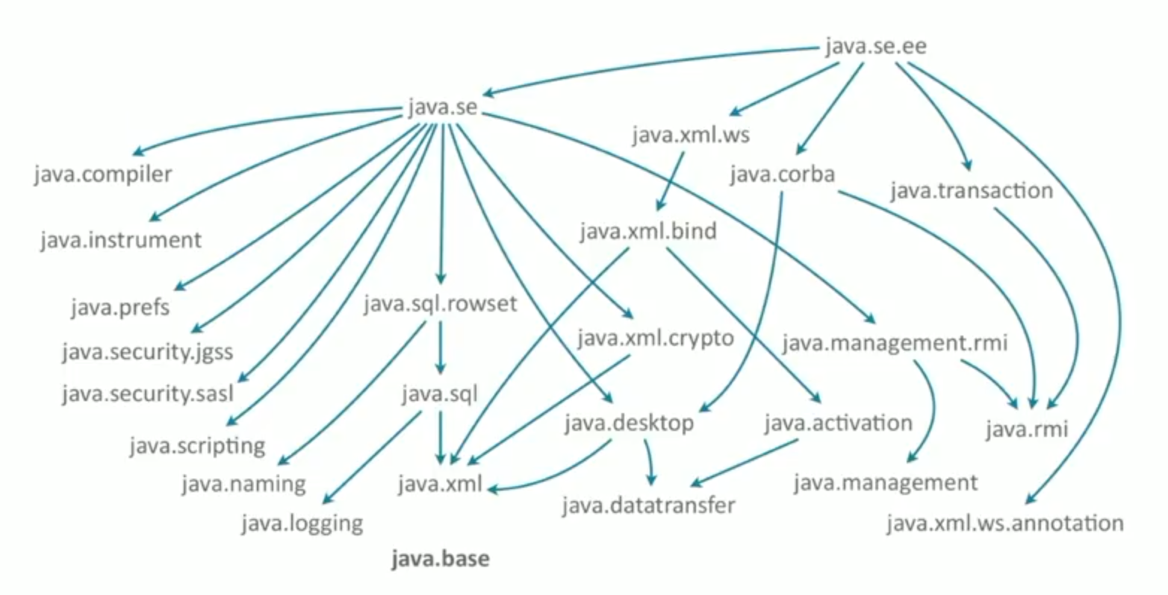
Java 9 Modularity – JDK Module Graph

Slide 9
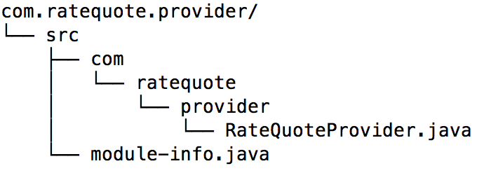
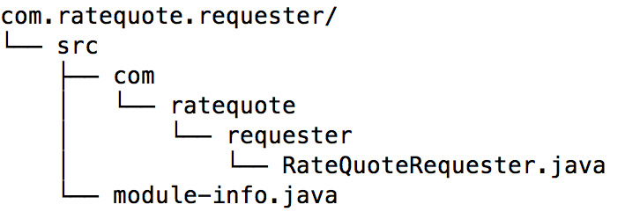
Java 9 Modularity - MODULES
module-info.java
module com.ratequote.provider {
exports com.ratequote.provider;
requires java.base;
}
module-info.java
module com.ratequote.requester {
requires com.ratequote.provider;
requires java.base;
}

Slide 10
Java 9 Modularity – MODULE Directives
The following are the module directives introduced in order to work with
Modules and the module path :
requires : specifies module A can read module B
requires transitive – implied readability : specifies that module A can read module B
and also any module that requires module A can also transitively read module B.
exports and exports … to : specifies that one of the module’s packages should be
accessible to code in all other modules.
uses : specifies a service used by this module – making the module service consumer.
provides with : provides a service implementation- making the module service provider.
opens & opens .. to: Allows runtime-only access to a package
for example: to allow reflection at runtime like ( Jackson/JAXB libraries )

Slide 11

Java 9 Modularity
Basic Hello World Example
Add exports and imports to a Module
jlink
jdeps
jshell
JDK Documentation and Module Graph

Slide 12
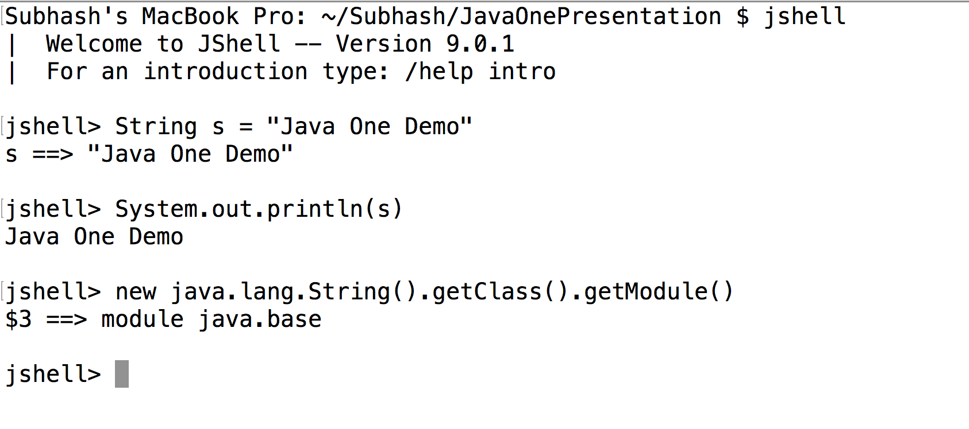
Java 9 Modularity – Other Significant Additions
REPL ( Read Evaluate Print Loop ) is now available in java too through JSHELL

Slide 13
Java 9 Modularity – Other Significant Additions
Immutable Collections can now be created through Collection Factories
List.of()
Set.of()
Map.of()
Old way of Creating Collections :
List<RateQuote> qList = new ArrayList<>();
qList.add(new RateQuote(“Q1234”);
qList.add(new RateQuote(“Q5678”);
qList.add(new RateQuote(“Q9012”);
qList = Collections.unmodifiableList(myList);
Using Collection Factories :
List<RateQuote> qList =
List.of(
new RateQuote(“Q1234”),
new RateQuote(“Q5678”),
new RateQuote(“Q9012”));

Slide 14
Java 9 Modularity – Other Significant Additions
Enhancements to Optional Class introduced in JAVA 8:
ifPresentOrElse(Consumer action , Runnable emptyAction ) :
Similar to ifPresent , but if there is no Value, it executes emptyAction Runnable passed in .
Stream() :
Returns a stream of 0 or one elements, depending on whether there is a value.

Slide 15
Java 9 Modularity – Other Significant Additions
Examples of some enhancements to Stream API introduced in JAVA 8:
ofNullable
Stream.of(“Q1234” , “Q5678” , “Q9012” )
.flatMap(key -> {
String quote = System.getProperty(key);
return prop == null ? Stream.empty(): Stream.of(quote);
})
.findFirst()
.orElseThrow(IllegalStageException::new);
Stream.of(“Q1234” , “Q5678” , “Q9012” )
.flatMap( key -> Stream.ofNullable(System.getProperty(key)))
.findFirst()
.orElseThrow(IllegalStageException::new);
Java 8
Java 9
takeWhile and dropWhile
List<RateQuote> quotes = quotesListInDescOrdrLnAmt
.stream()
.filter(quote -> q.getLoanAmount() >=450000)
.collect(Collectors.toList());
List<RateQuote> quotes = quotesListInDescOrdrLnAmt
.stream()
.takeWhile(quote -> q.getLoanAmount() >=450000)
.collect(Collectors.toList());
Java 8
Java 9

Slide 16

Java 9 Modularity – Adoption/Challenges/Questions
Is it right time to adopt java 9 ?
How easy is it to understand and design an app in java 9 ?
I have a lot of legacy code base.Is it easy to upgrade my legacy code base to Java 9 ?
Is it fully backward compatible like the previous Java versions ?

Slide 17
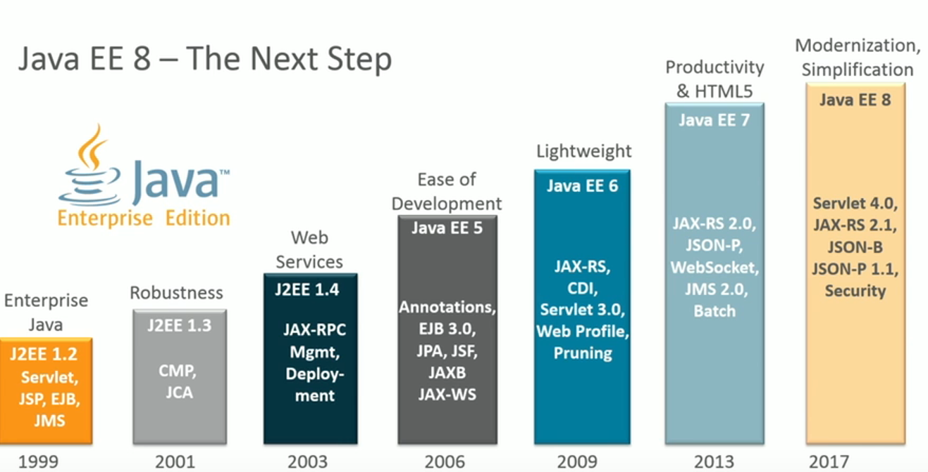
Java EE 8 – Road to Java EE 8

Slide 18
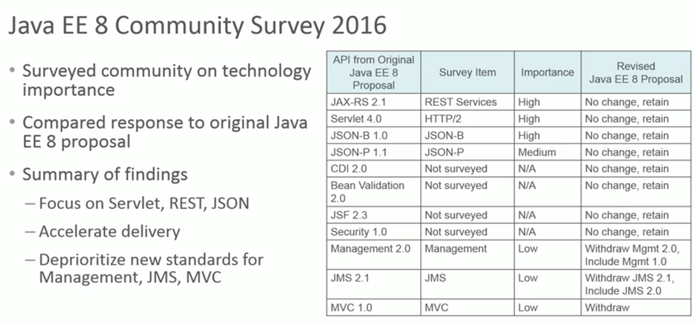
Java EE 8 – Road to Java EE 8

Slide 19
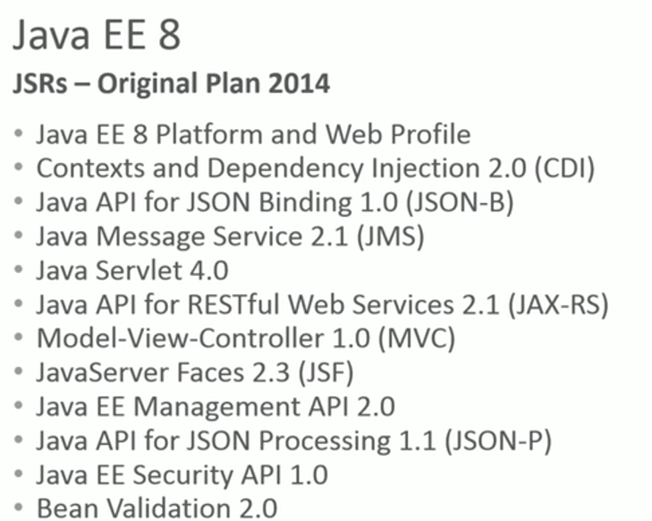
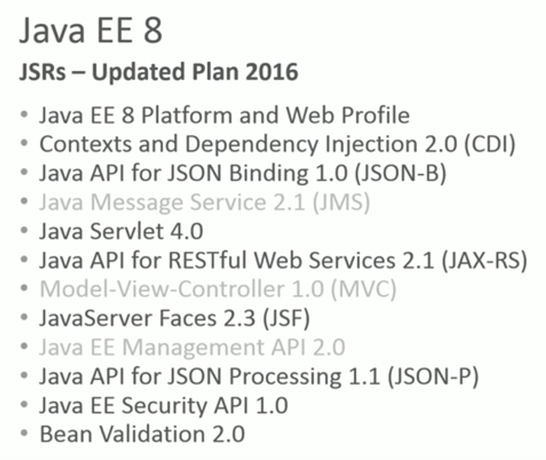
Java EE 8 – Road to Java EE 8

Slide 20
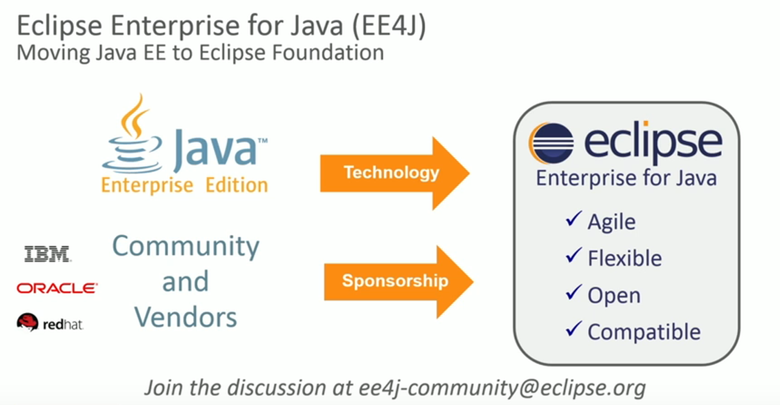
Java EE 8 – Road to Java EE 8

Slide 21

Java EE 8 – EE4J / Micro profile
What is EE4J ?
Eclipse Enterprise for Java (EE4J) is an open source initiative to create standard APIs,
implementations of those APIs, and technology compatibility kits for Java runtimes that
enable development, deployment, and management of server-side and cloud-native apps.
https://projects.eclipse.org/projects/ee4j/charter
What is Eclipse Microprofile ?
The microprofile.io community (http://microprofile.io/) is a semi-new community dedicated
to optimizing the Enterprise Java mission for micro service based architectures.
The goal is to define a micro services app platform that is portable on multiple runtimes .
https://projects.eclipse.org/proposals/eclipse-microprofile

Slide 22




Java EE 8 – EE4J / Micro profile
Who are the Major Players in the eclipse micro profile ?

Slide 23
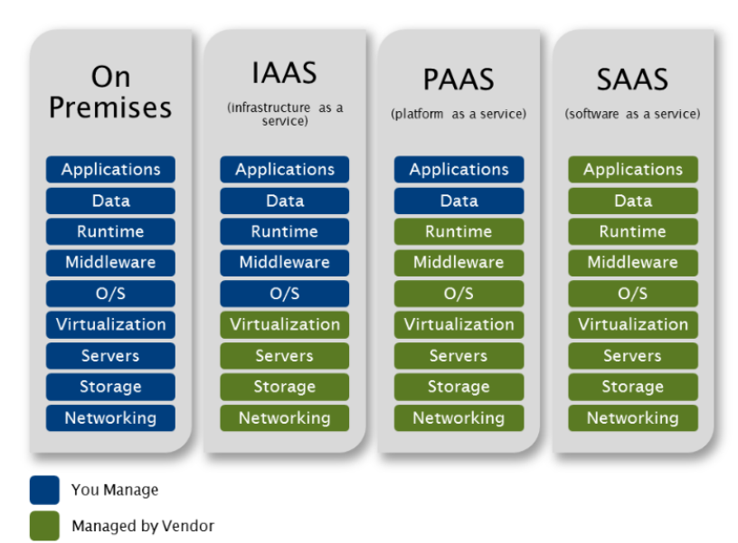
Serverless Cloud –
Traditional Cloud stack of services

Slide 24
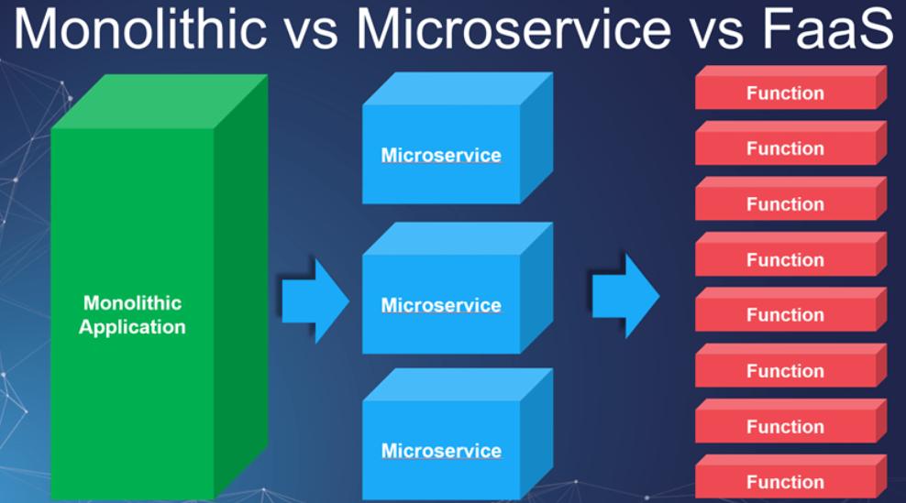
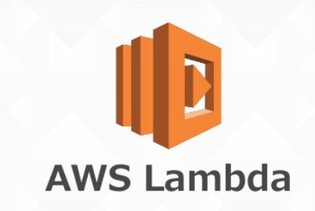




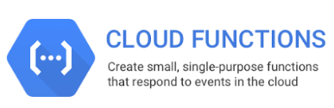
Serverless Cloud – FaaS ( What is it ? )
Does it not have any servers ?
What is it and Who hosts it ?
Who manages it ?
Is there a subscription fee for it ?

Slide 25
Serverless Cloud – Oracle announces FN project
Oracle joins the cloud wars for FaaS with FN project .
FN is an event driven, open source , Functions as a service compute platform that
You can run anywhere . Its GIT repository is made public in Java One 2017 Key note session.
The GitHub link for the open source project
https://github.com/fnproject/fn
Written in Go
Can be run in local with in minutes after reading the Github ReadMe doc for quick start.

Slide 26
Serverless Cloud – Helloworld on AWS Lambda
Create a Simple Function in Java in Eclipse AWS tool kit
Export it as a Jar file
Upload the Jar on to AWS lamba using AWS management console
Run a test and view the logs in AWS management console

Slide 27
Microservices – Wide spread adoption and maturing of microservices architectures .
The current Programming communities are widely adopting the micro services patterns
in their application architectures.
Major patterns like Circuit Breakers , Service Discovery, Containerization
are being adopted widely in the java community.
Examples of Frameworks that facilitate the use of micro services :
Netflix OSS ( Open Source Software )
Spring Cloud with Netflix OSS
Explore Netflix Eureka and Netflix Hysterix dashboards to view their features.
https://github.com/Netflix/eureka
https://github.com/Netflix/Hystrix
https://github.com/spring-cloud-samples/eureka

Slide 28
Reactive Programming – Change in the programming paradigms and mindsets
Traditional Imperative Style Programming :
You tell the program WHAT to do and HOW to do .
Functional Style Programming :
You tell the program WHAT to do and the rest is taken care
by a function/higher order function.
Reactive Style Programming :
It’s a next step to the Functional Style programming . Where the programs react to the
stimuli and execute the higher order function.

Slide 29
Reactive Programming –Example of Imperative Style
Find the Loan with highest RQI value in the year 2017 :
List<Loan> loans = createLoansList();
double highestRQI = 0.0 ;
for( Loan loan : loans) {
if( loan.getLoanYear() == 2017 ) {
if(loan.getRQI() > highestRQI ) {
highestRQI = l.getRQI();
}
}
}

Slide 30
Reactive Programming –Example of Functional Style & Differences with imperative style
Find the Loan with highest RQI value in the year 2017 :
Imperative
Functional
List<Loan> loans = createLoansList();
double highestRQI = 0.0 ;
for( Loan loan : loans) {
if( loan.getLoanYear() == 2017 ) {
if(loan.getRQI() > highestRQI ) {
highestRQI = l.getRQI();
}
}
}
List<List> loans = createLoansList();
double highestRQI = loans
.filter( loan -> loan.getLoanYear() == 2017 )
.map(loan -> loan.getRQI())
.max();
Every Value is associated with a variable
that can change.
Order of execution matters
Repetition is controlled by programmer
Every Value is associated only once
and will never change
Order of execution is not defined.
Repetition is controlled by library

Slide 31
Reactive Programming –Lazy Evaluation in Functional Style Programming
public static void main(String[] args) {
IntStream stream = IntStream.range(1,5) ;
stream = stream.peek(i -> log(“start-”+i)
.filter(i-> {
log(“filtering-” +i);
return i%2 == 0 ;
})
.peek(i->log(“after filter”+i);
log(“After the stream statement “) ;
log(“ The count in the stream is” + stream.count());
}
Output :
After the steam statement ( Notice that This statement is printed first )
start -1
filtering-1
start -2
filtering-2
after filter-2
start -3
filtering-3
start -4
filtering-4
after filter-4
The count in the stream is 2

Slide 32
Reactive Programming –Next step to Functional style
The main pillars of the Reactive programming are :
They are elastic
They are Event driven / Asynchronous
They are responsive with lazy evaluation and respond only when its needed.
They are resilient.
Examples:
Excel sheet value calculations on update of a cell
Updating every mobile/webapp about the Stock price when it changes

Slide 33
Reactive Programming –
CompletableFuture ( java 8) , RxJava –Reactive Extensions
public class HelloWorldCompletableFuture {
public static void main(String[] args) throws InterruptedException, ExecutionException {
CompletableFuture<String> bestTravelFuture
= CompletableFuture.supplyAsync(HelloWorldCompletableFuture::findBestFlight)
.thenCombine(CompletableFuture.supplyAsync(HelloWorldCompletableFuture::findBestHotel), (s1,s2)-> s1+s2);
System.out.println(“Executing Other OPERATIONs");
System.out.println(bestTravelFuture.get()); // Blocking Call which waits for both threads to finish
}
}
private static String findBestHotel() {
System.out.println("Insider the findBestHotel");
try {
Thread.sleep(1000l);
} catch (InterruptedException e) {
e.printStackTrace();
}
System.out.println("After calculating best Hotel ");
return "Mariott";
}
private static String findBestFlight() {
System.out.println("Insider the findBestFlight ");
try {
Thread.sleep(2000l);
} catch (InterruptedException e) {
e.printStackTrace();
}
System.out.println("After calculating best Flight");
return "Delta - 507";
}
Output:
Insider the findBestFlight
Insider the findBestHotel
Executing Other OPERATIONs
After calculating best Hotel
After calculating best Flight
Delta - 507Mariott

Slide 34
Mobile App Development using Java
Gluon :
A Mobile Application Development Platform to build Native Mobile apps using Java.
The Gluon product builds the native App based on the Device Type, by converting
the java code in to the native app.
Single App, Multiple Platforms ( Based on Java – end to end )
Drag & Drop, Rapid Application Development with Scene Builder for Java FX
Hardware: Abstracted
High performance
Cloud Connected

Slide 35


